Slide 1

Revitalizing Resilience: A Strategic Analysis for a Customer-Centric Sales and Marketing Enhancement Plan at PJ Computer
Submitted By – Anish Maity.
Roll – 21f3000417
Email - 21f3000417@ds.study.iitm.ac.in

Slide 2

Organization Background
The PJ Computer Cyber Cafe, established in 2020 by Pranabendu Jana, is a community-centric digital service hub located in Ramnagar I, Purba Medinipur, West Bengal. The cafe provides many services for students, job seekers, and the local community like scholarship applications, college admissions, and many other online and designing services.
Vision : To bridge the information gap for students and local community ,
providing them with access to essential services and digital support.
Mission : Empower rural communities with affordable accessible and high
quality services that support academic career and personal development.
Services :
Scholarship application.
Job Application.
College Application
Professional Service
Government services
Main Customer is student.

Slide 3
Business Difficulties(Issues)
Sudden price hikes without proper communication.
low community awareness of its services due to a lack of effective marketing.
Increased competition from similar service providers.
Negative publicity from certain individuals.
Operating with a small team has resulted in delays and reduced service quality.

Slide 4
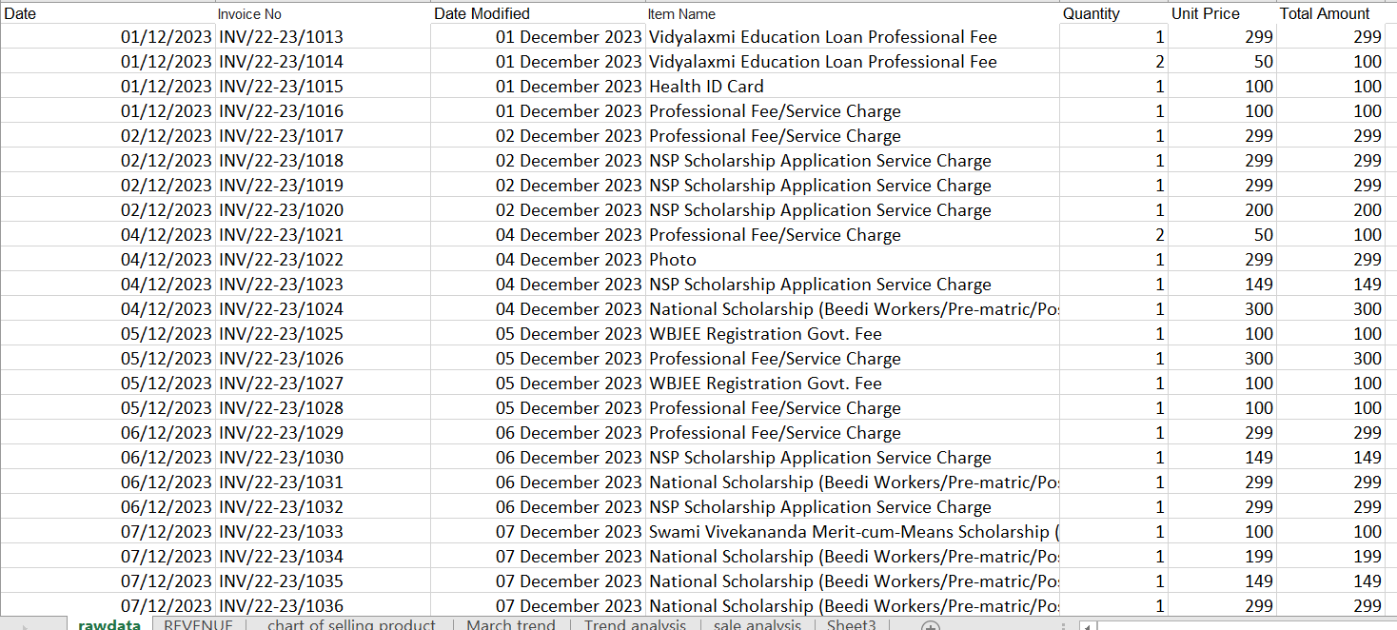
Data Collection and Analysis Process
The company maintains Google sheet containing daily sales record.
Data of net sales is collected from December 2023 to March 2024.
Data cleaning & Understanding
Sale Quantity of every service.
Popular Service.
Structured
Data
Revenue Analysis.
Time series Trend analysis.

Slide 5
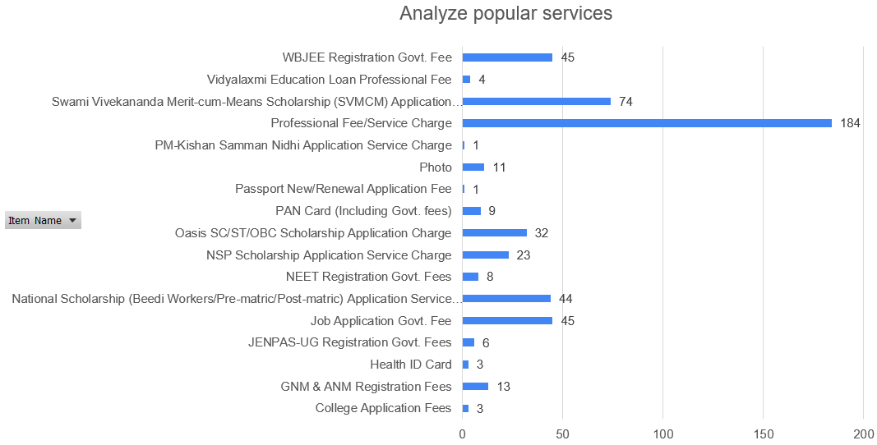
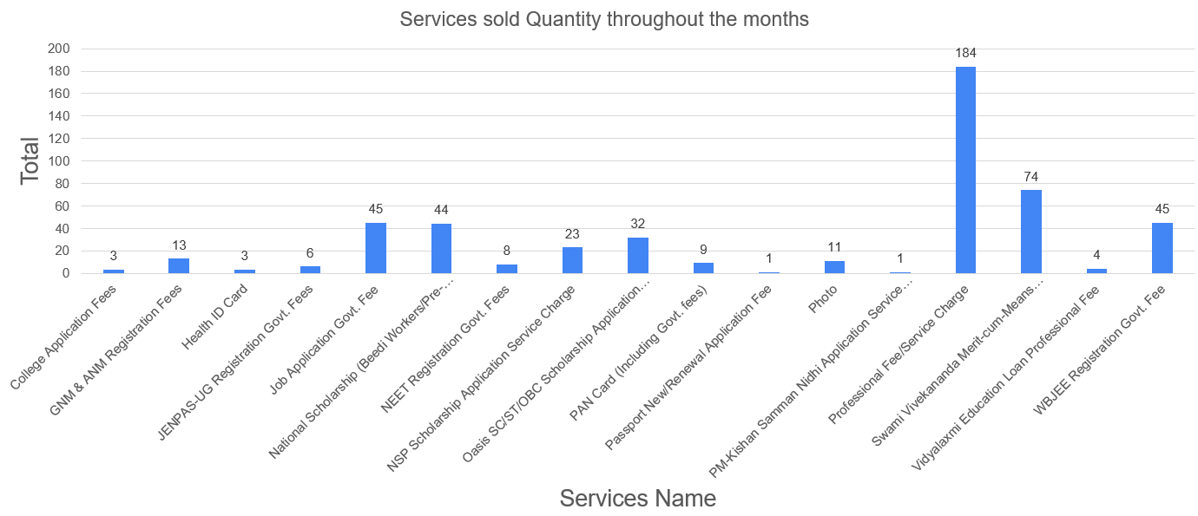
Result & Findings
Overall sold quantity and popular services

Slide 6
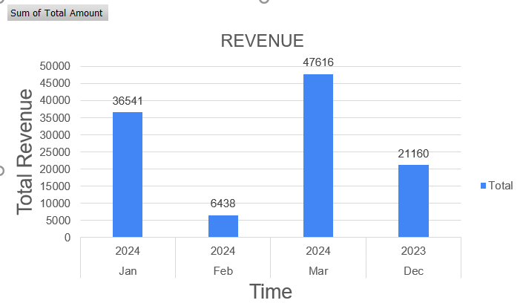
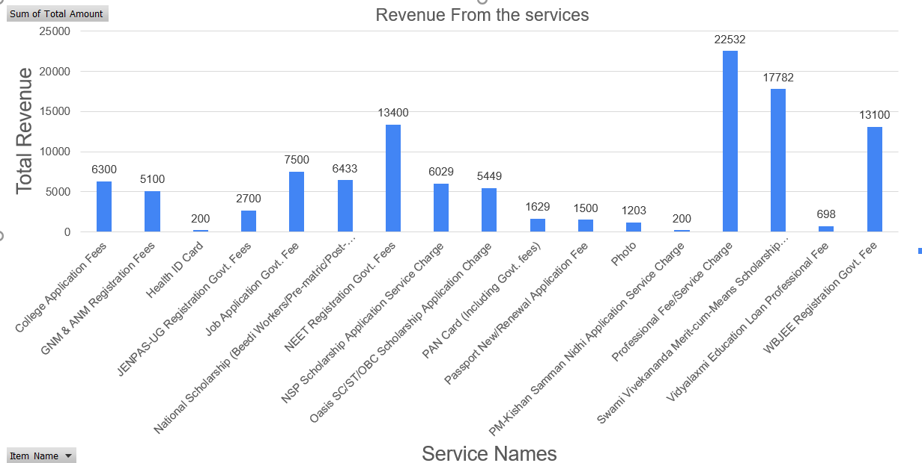
Revenue Analysis :

Slide 7
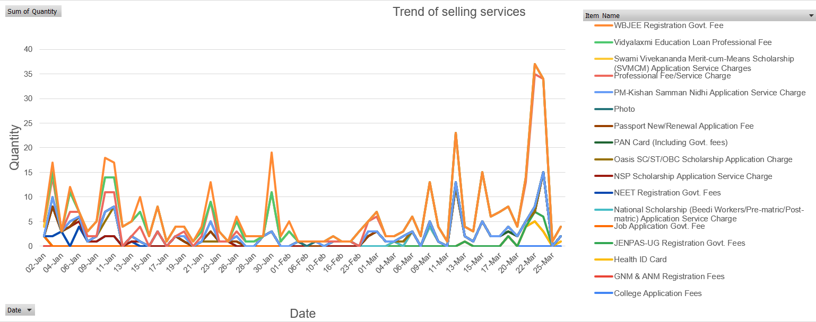
Trends on Sales :
Overall Trend

Slide 8
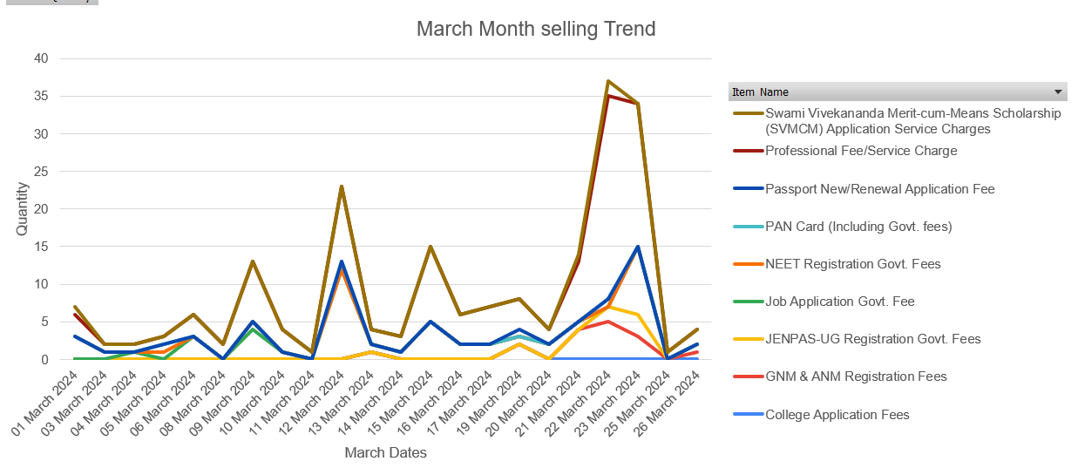
Trends on Sales :
Last Month Trend

Slide 9
Recommendation for owner :
Service Enhancement :
Promote Signature Services: Highlight and prioritize "Professional Service" and "Swami Vivekananda Scholarship" as flagship offerings.
Expand Service Offerings: Add video editing, photography, videography, document binding, custom printing to the service list.
Introduce New Scholarship Services: Provide assistance for private and non-governmental scholarships and support for students below Class 8.
Photo Restoration & Editing: Introduce photo restoration services to meet customer demand and stay ahead of competitors.
Online & Digital Presence :
Launch Online Services: Provide online submissions, consultations, and document processing to attract a broader audience.
Build a Digital Presence: Create a website for service booking and promote offerings on social media (e.g., Facebook).
Staffing & Service Quality:
Hire Additional Support Staff: Employ interns or beginners (₹5,000–₹8,000 salary) to fill staffing gaps while maintaining profitability.
Improve Service Consistency: Ensure consistent availability of high-demand services to meet customer needs.
Discount Offers :
Bundled Exam Registrations: Offer ₹200 off for registering for 2+ exams (e.g., WBJEE, NEET, JENPAS-UG).
Scholarship Package Deals: Offer ₹50 off for students applying for 3 scholarships (e.g., SVMCM, National, and Oasis scholarships).
Customer-Centric Strategy :
Customer Feedback Surveys: Collect customer feedback to refine services and address customer pain points.
Continuous Service Innovation: Stay ahead of competitors by continuously introducing new, in-demand services.

Slide 10
Acknowledgement :
I would like to express my gratitude towards Dr. Ashwin J. Baliga, Dr. G Venkatesh, Dr. Milind Gandhe, Dr. Aaditya Chandel sir for their continuous support and guidance, Business owner Mr. Pranabendu jana for being supportive and being together in this journey.
Thank You.

